Slide 1
CSET301 – AI-ML
Lecture 24 : Hierarchical Clustering

Slide 2
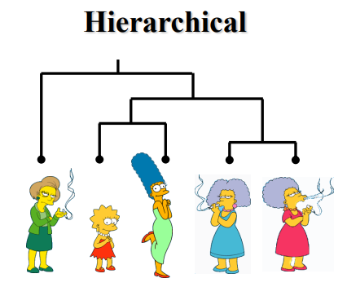
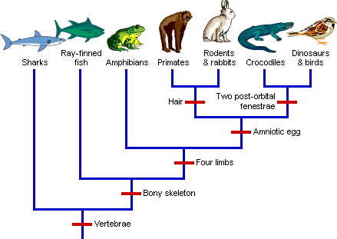
Hierarchical clustering
Produces a set of nested clusters organized as a hierarchical tree.
Hierarchical clustering may correspond to meaningful taxonomies.
Phylogeny tree

Slide 3

Types of Hierarchical clustering
Agglomerative (Bottom-Up approach): Each data point is treated as a single cluster and then successively merge or agglomerate the pairs of clusters.
Divisive (Top-down approach): All the data points are treated as one big cluster and the process of clustering involves dividing the one big cluster into various small clusters.
Hierarchical Clustering
Agglomerative
Divisive

Slide 4
Types of Hierarchical clustering
Agglomerative (Bottom-Up approach)
Divisive (Top-down approach)
Step 0
Step 1
Step 2
Step 3
Step 4
agglomerative
(AGNES)
a
a b
b
a b c d e
c
c d e
d
d e
e
divisive
(DIANA)
Step 4
Step 3
Step 2
Step 1
Step 0

Slide 5
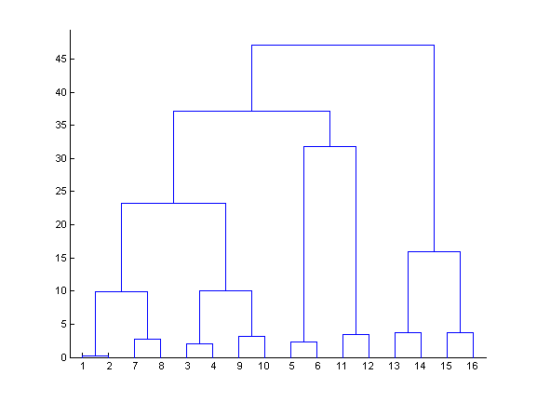
Dendogram
Hierarchical clustering can be visualized as a dendogram.
The final cluster is the root and each data item is a leaf.
The height of the bars indicate distance between clusters.

Slide 6
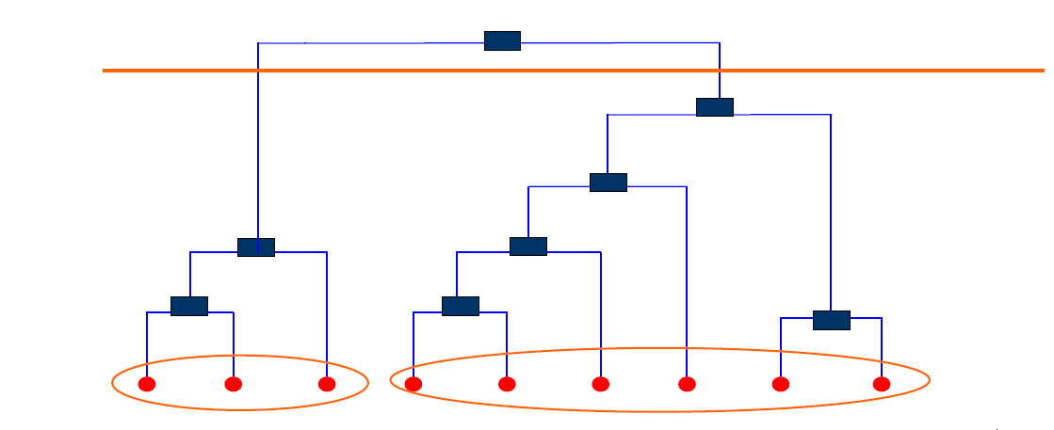
Strengths of Hierarchical clustering
No need to assume any number of clusters.
Any desired number of clusters can be obtained by ‘cutting’ the dendrogram (hierarchical tree) at the proper level.

Slide 7
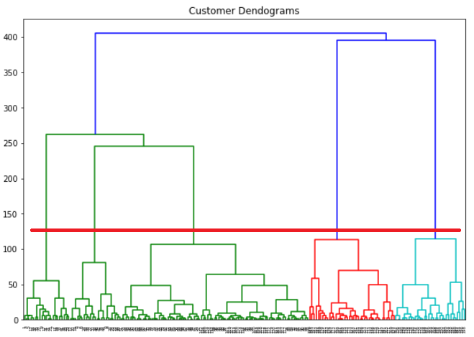
Strengths of Hierarchical clustering
A clustering of the data objects is obtained by cutting the dendrogram at the desired level, then each connected component forms a cluster

Slide 8
Agglomerative clustering algorithm
Most popular hierarchical clustering technique
Algo:
Compute distance matrix between the input data points
Let each data point be a cluster
Repeat
  Merge the two closest clusters
  Update the distance matrix
Until only one cluster remains
Key operation is the computation of distance between two clusters: Different definition of distance between clusters lead to different algorithms

Slide 9
Linkage methods
Linkage methods determine how the distance between clusters is calculated when merging them. These methods define the similarity (or dissimilarity) between groups of data points.
Common Types of Linkage Methods
Single-Linkage
Complete-Linkage
Average-Linkage
Ward-Linkage

Slide 10

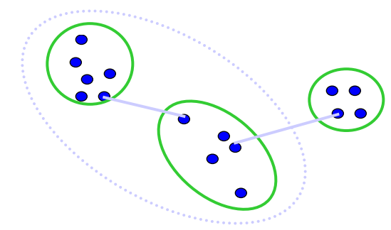
Single Linkage
Distance between two clusters = minimum distance between any pair of points (one from each cluster).
Can form long, chain-like, skinny clusters (suffers from chaining effect).

Slide 11

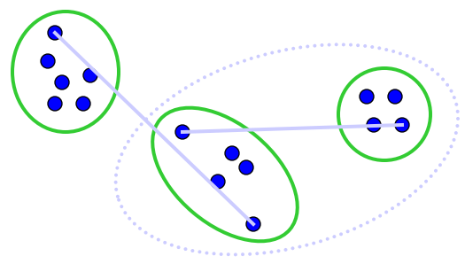
Complete Linkage
Distance between clusters = maximum distance between any pair of points (one from each cluster).
Produces compact and tight clusters; sensitive to outliers.

Slide 12

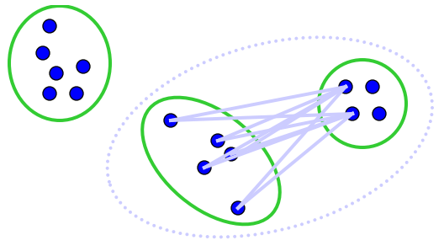
Average Linkage
Distance = average distance between all pairs of points (one from each cluster).
Balances chaining and compactness, robust against noise; widely used in practice.

Slide 13

Ward’s Method
Merges clusters that result in the minimum increase in total within-cluster variance
Produces clusters of similar size; often yields the best overall structure.
  Ward’s method says that the distance between two clusters: A and B, is how much the sum of squares will increase when we merge them.
  Sum of the squares grows as we merge the clusters.
  Ward’s method keeps this growth as small as possible.

Slide 14
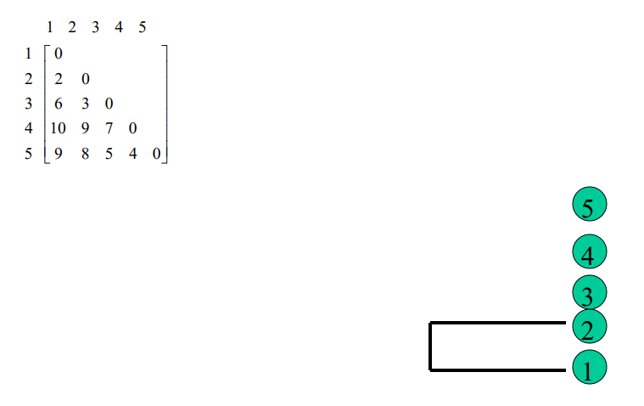
Example: Single Link

Slide 15
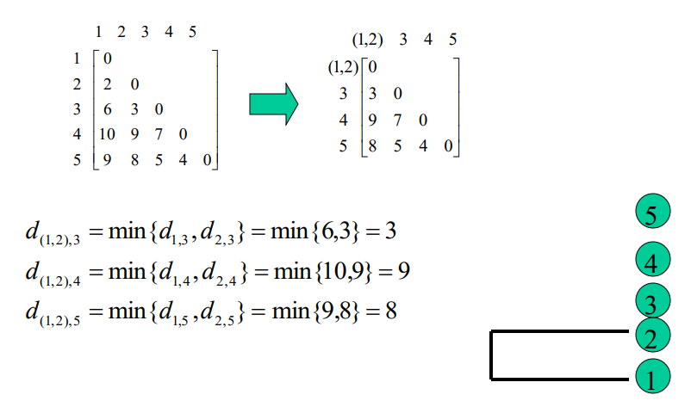
Example: Single Link

Slide 16
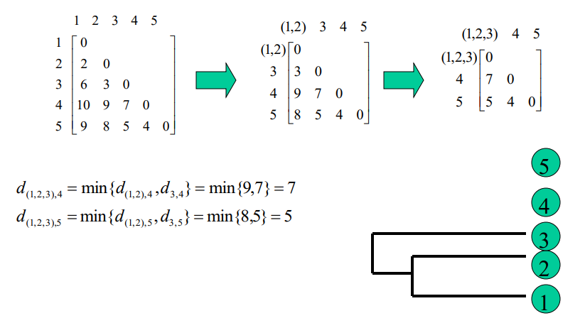
Example: Single Link

Slide 17
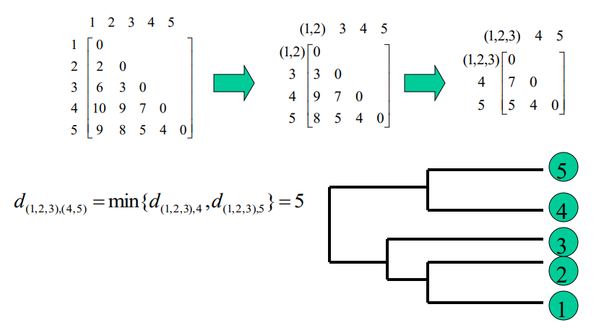
Example: Single Link

Slide 18
Summary
No need to specify the number of clusters in advance.
Hierarchical structure maps nicely onto human intuition for some domains
They do not scale well: time complexity of at least O(n 2 ), where n is the number of total objects.
Like any heuristic search algorithms, local optima are a problem.
Interpretation of results is (very) subjective.

Slide 19
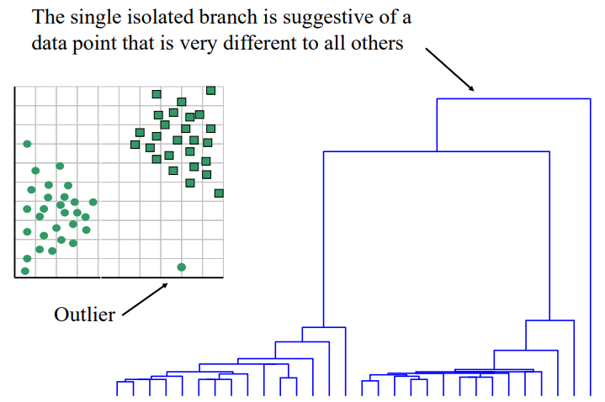
One potential use of dendogram

Slide 20
Thank You

